Slide 1



SHIFT 3 - Final Pitch
04.11.2023
Notes:
DIANA We are Shift+Enter team, Enter comes from the action to make this SHIFT project real.

Slide 2





People from underrepresented groups want to launch their career in Tech.
Companies are looking for motivated individuals and recognise the benefits of diversity.
Facilitate the Integration of Underrepresented Groups into the Swiss Labor Market
Notes:
PRESENTER: DIANA There are people with changing career to Tech specializations or starting in their careers in switzerland.
At the same time there are companies looking for talent and that recognise the benefits from diverse teams.
With the Shift project, we aim to facilitate the integration of underrepresented groups into Swiss Labor market and in collaboration with associations like Women++ and Power.Coders.

Slide 3
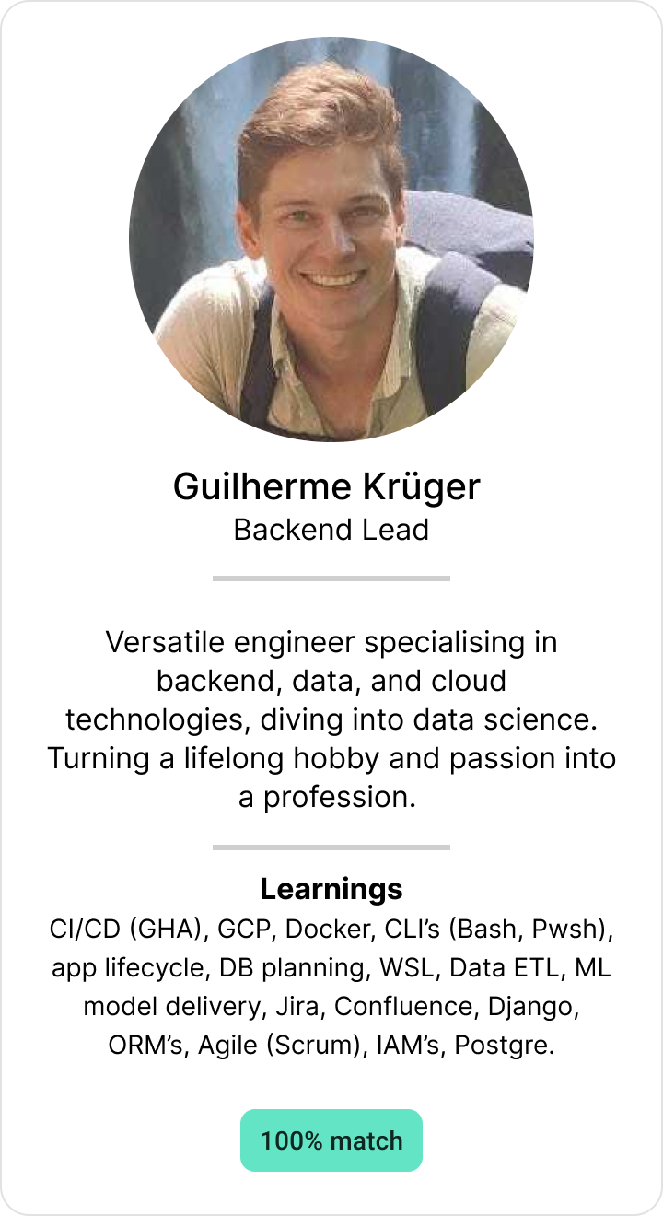
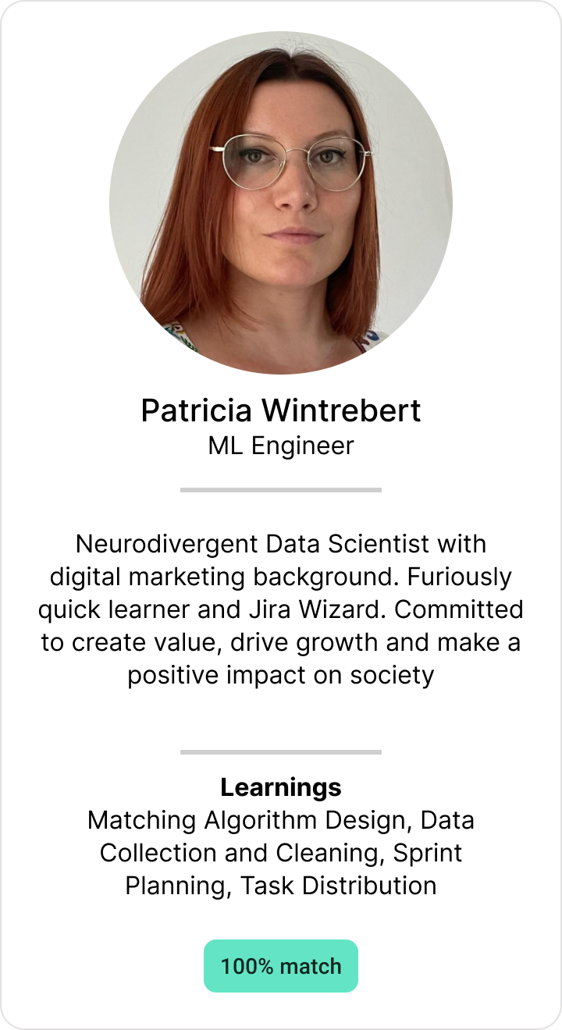
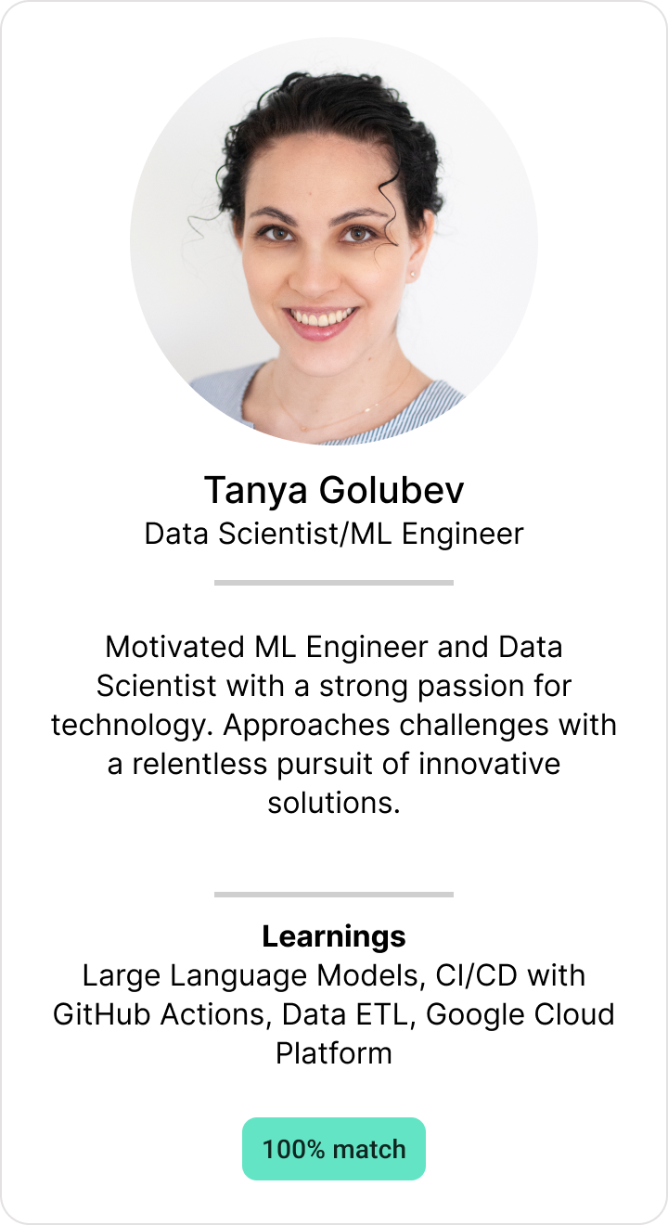




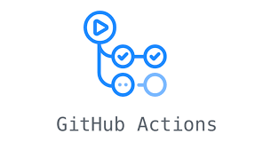

The Team Backend & Data Science
100% match
Notes:
PRESENTER: DIANA
Guil: Versatile backend, data and cloud engineer
Patricia: Data Scientist and Jira Wizard, with marketing background.
Tanya: Machine Learning Engineer, with a “never give up” mindset.

Slide 4
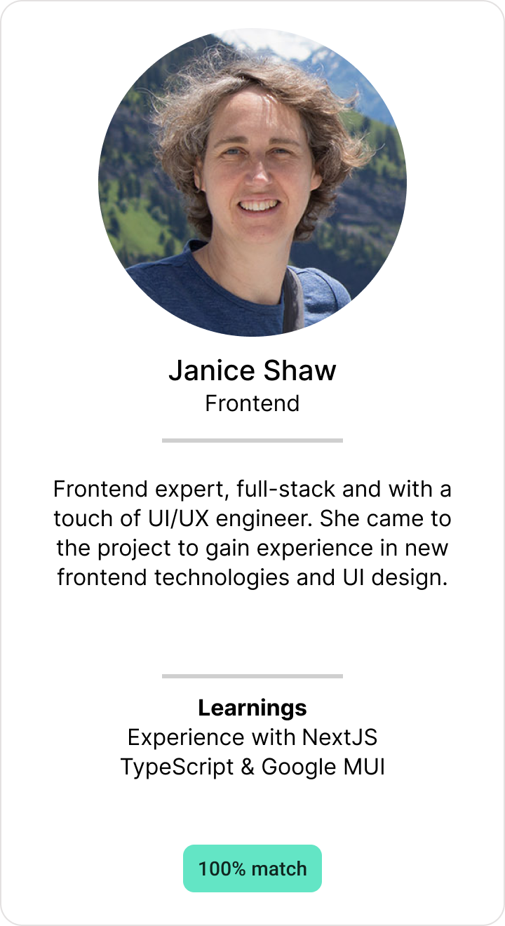
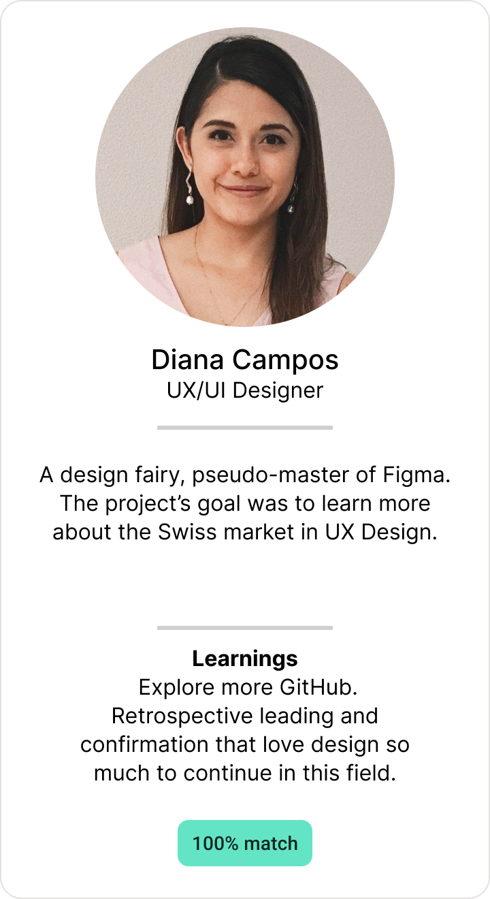
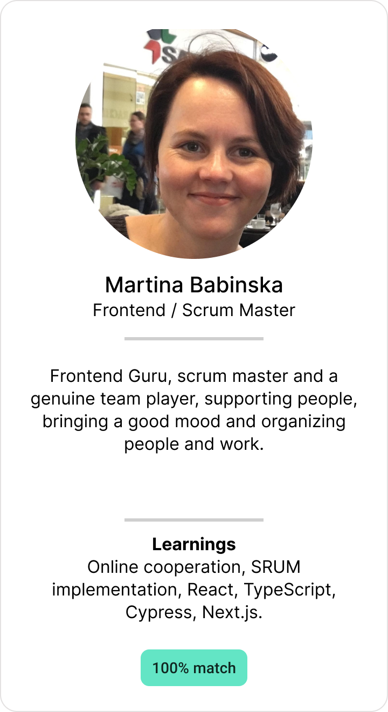
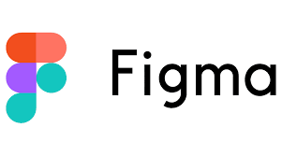




The Team Frontend & UX/UI Design
Notes:
DIANA
Janice: Frontend expert and support in UI/UX
Diana: a Design fairy, Figma fan/lover!
Martina: Frontend Guru, scrum master

Slide 5









Teams development Learning to adapt
STAGE 5
STAGE 1
STAGE 1
PRIDE!
STAGE 4
EXCITEMENT!
STAGE 4
EXCITEMENT!
STAGE 2
STAGE 2
STAGE 3
STAGE 3
STAGE 3
STAGE 3
DETERMINATION!
DETERMINATION!
THOUGHTFULNESS!
THOUGHTFULNESS!
PANIC!
PANIC!
Notes:
PRESENTER: MARTINA
At the beginning - waaw exciting, new project, with great learning opportunities.
However, we soon realized the enormity of the tasks, our project manager left us and we felt.. well.. PANIC.
Yet, we regrouped and found our way forward.. and as we near the conclusion, we're astounded by what we've accomplished.

Slide 6
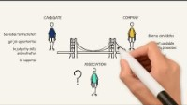
Notes:
RESENTER: MARTINA
Candidate - a determined individual seeking for a career in tech industry.
Company - company which is searching for diversity and inclusion within their teams.
Associations - who try to bridge these two groups by hosting workshops, bootcamps, and hackathons.
..However it is not easy because they face many requirements from both sides…
Candidates: wants to be visible for recruiters and wish to be updated about the job opportunities. They wish to be judged only based on their core skills and motivation, rather than personal characteristics. And they wish to be supported on their career journey.
Companies: Strive to build a diverse talent pool. However, the hiring process need to be quick and efficient. And of course, they also wishe to be supported in their needs.
Associations: Thought how to build a nice bridge between these two groups and they came with the idea:
=> SHIFT - MATCHING PLATFORM
our solution roots in these ideas…
ML based matching - To join recruiters and candidates
Blurring / on click unblurring personal information - To ensure fair and bias free recruitment process
Best practice and education - To support companies and candidates
Let’s see what how we had implemented these features…

Slide 7
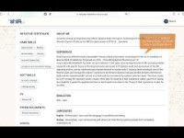
Notes:
PRESENTER: TANYA

Slide 8
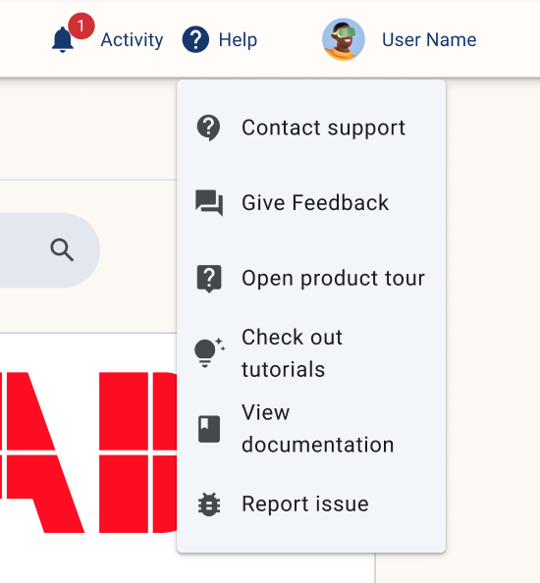
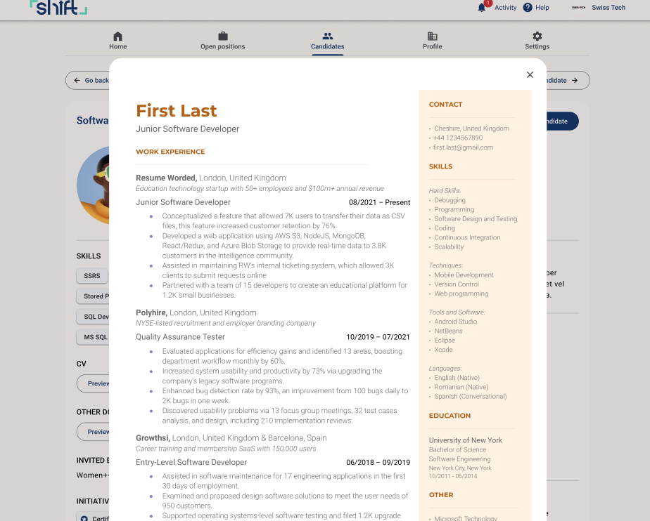
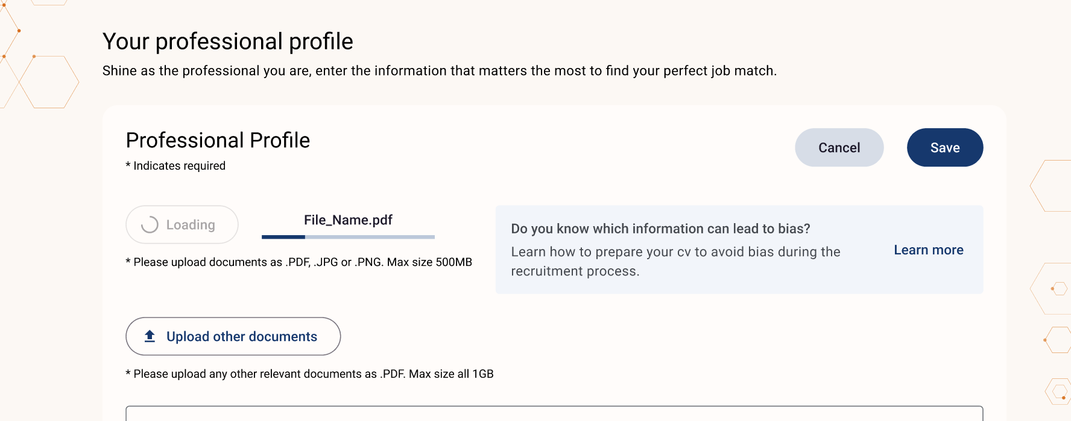
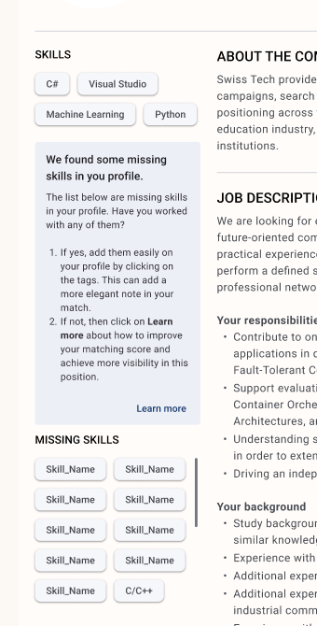
Roadmap And the next steps
Improvements to responsiveness
Help candidates to improve their profile
Association flow - invite only email
Notifications inside the app
DESIGNED
IN DEVELOPMENT
NEXT STEPS
Balanced matching
Email notification
Preview of documents
Collection of feedback
GDPR Compliance
Reward active companies
Onboarding process
Mobile app
Notes:
PRESENTER: PATRICIA (in case DIANA)
In Development: finalize the balance matching process Designed: Help candidates to improve the profile
Next steps: GDPR Compliance

Slide 9
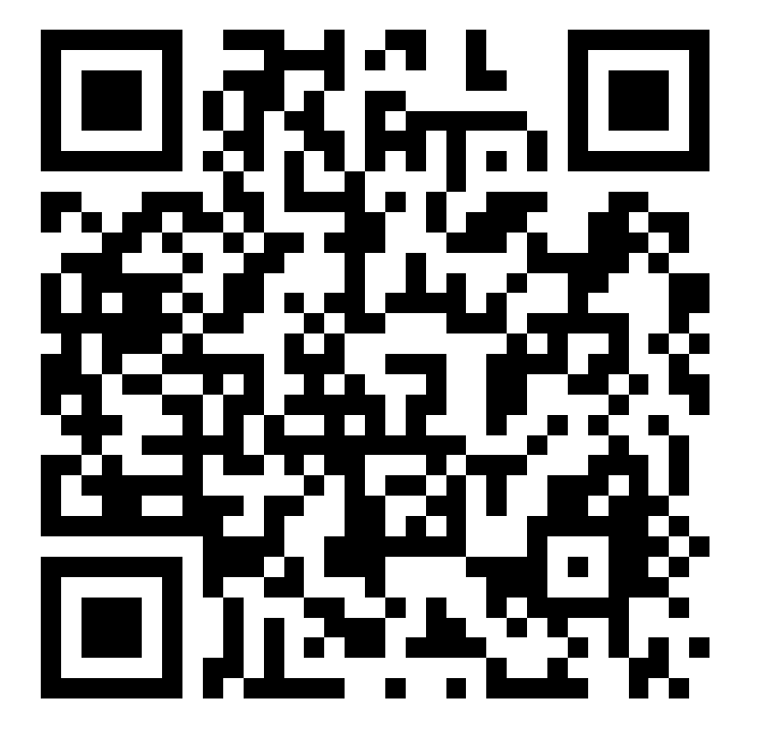
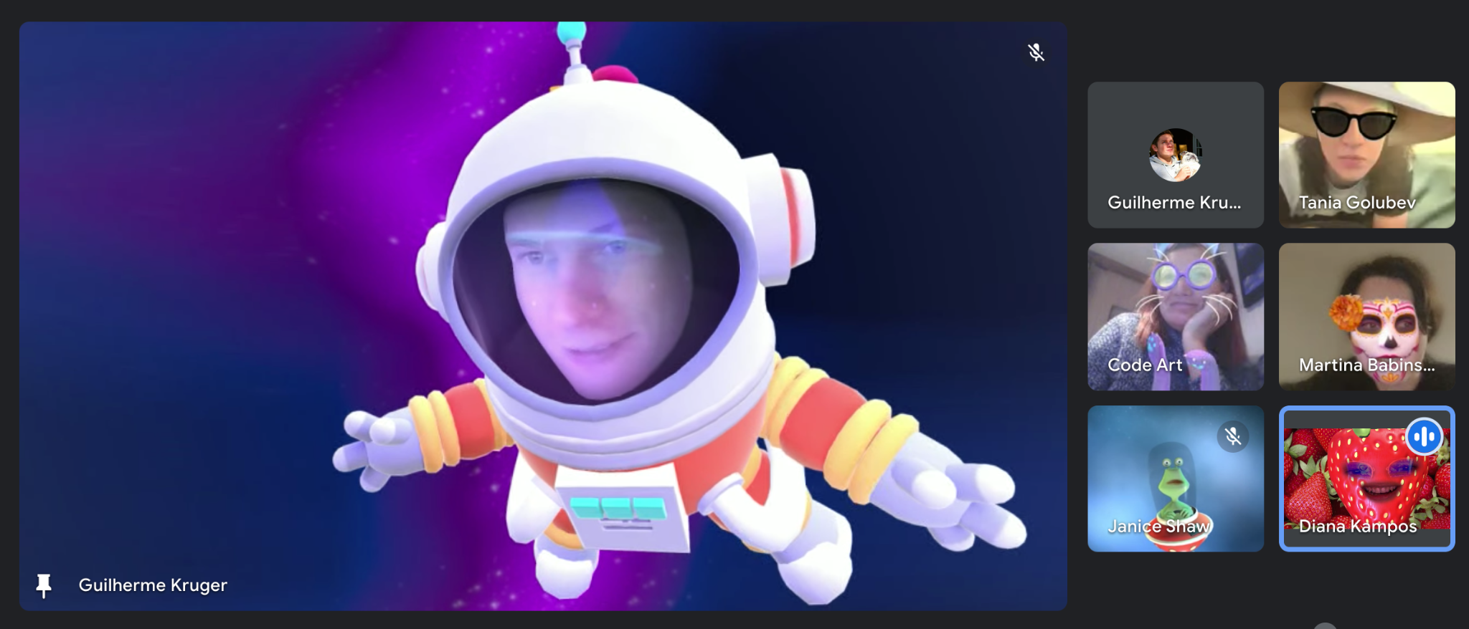
What we learned
Tech stack to design, develop and deploy ML-based web application; CI/CD, security. Agile development techniques, effective online collaboration, and harnessing the benefits of a diverse team.
Thank you!
Notes:
PRESENTER: PATRICIA (in case DIANA)
SAY THANKS and connect through the QR code

Slide 10
Appendix What we learned as a team and our learning journey
Diana: I'm glad I got more experience in UX strategy and leadership in my role and had the opportunity to be part of the decision making process, especially with such a short time to build a product and a group from scratch. I was also nervous about using GitHub, but luckily I didn't screw it up!
Tanya: I learned the composite parts of a web application, all the parts interact together to create a product. I got deeper knowledge of supporting tools for development: CI/CD, testing, git worktrees.
Patricia: I've learned how important it is to create a framework that encourages parallel work. Good communication and task sharing are key. Personally, I've made a lot of progress in data science, especially in natural language processing (NLP) and sprint planning.
Janice: My goal was to gain experience in frontend development using technologies I had not previously used, such as NextJS and TypeScript. Developing the application was an intensive learning experience. I look forward to widening my knowledge in a less time critical way :-).
Martina: I wanted to learn more about React and TypeScript. Though my progress in that area was limited, I gained valuable insights into working effectively online, balancing work and personal life, and I developed a deep appreciation for organizations that promote and aid diversity.
Guilherme: I learned how the application starts and gets deployed, and how all the parts come together to form one. I found DevOps very interesting, as it fits my background in engineering and my innate desire to automate workflows, streamline actions, and optimize processes.
Notes:
Q+A

